Slide 1
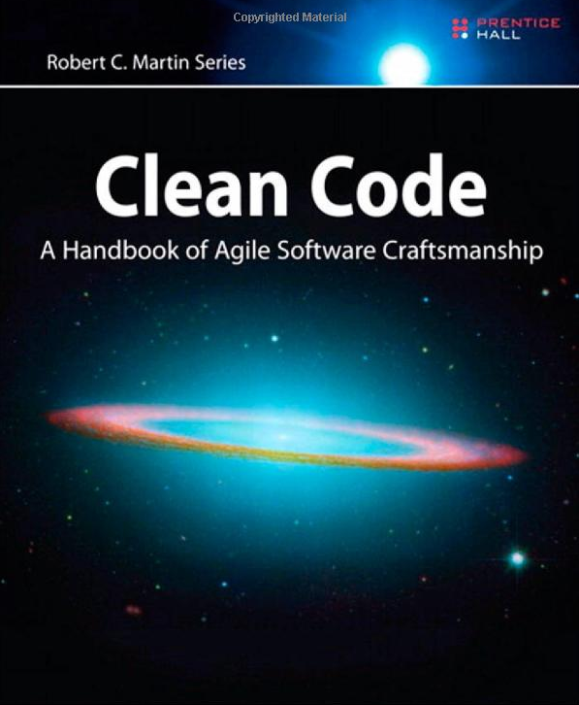
OnClean Code
Taming the spaghetti monster
Presented By:
Fernando Zamora
Copyright 2008 McLane Advanced Technologies, LLC

Slide 2
Agenda
Cover what “Clean Code” is
Why it’s important
Philosophy
Cover a few topics on how to write cleaner code
Names
Functions
Comments
Read code
Have Fun – there is no such thing as perfect code!!!!!
Exercises

Slide 3
Clean Code What is it?
Testable and tested
Elegant
Efficient
Expressive
Expected
Readable
Minimal Dependencies
Maintainable
Self Documenting
Simple

Slide 4
Bad Code – What is it?
Inappropriate Information (Regions)
Obsolete Comments
Redundant Comments
Poorly Written Comments
Commented out code
Too many arguments
Output arguments
Flag arguments
Dead functions
Duplication
Incorrect Behavior and Boundaries
Code at wrong level of abstraction
Base classes depending on their derivatives
Too much information
….

Slide 5
Why is Clean Code Important
Maintains fast productivity
It is costly to own a mess
Productivity decreases asymptotically eventually down to 0
Boy Scout Rule: Leave the code better than you found it

Slide 6
Philosophy
Just like martial arts has many masters with different styles, so does Clean Code
Decades of experience and deep thought
Intent is to provide you with principles and techniques to achieve writing clean code
Code is a living design

Slide 7
Choosing Names
Meaningful names
Avoid Disinformation – hp,
Avoid small variations in names – s1, s2
4. Meaningful Distinctions
if (!fundsAvailable || availableFunds < -0.004m)
5. Pronounceable Names - rptparam
6. Searchable Names – MAX_DAYS instead of 999
7. Avoid Encodings – e.g. Hungarian notation strName, strFName, Compiler
8. Function Names are verbs
9. Data fields are nouns

Slide 8
Choosing Names
Interfaces and implementations – IShapeFactory, ShapeFactory
Avoid mental mapping – i, a, b, c
Class names should have noun names
Functions should have verb names
With overloaded constructors use static factory methods instead
Don’t be cute – e.g. EatMyShorts instead of Abort
One word per concept – get, fetch, retrieve
Use solution domain names – JobsQueue
Use problem domain names –
Avoid gratuitous content – Gas Station Deluxe gsdAccount, gsdName, …

Slide 9
Exercises Part I
1. Create method with implementation
Class Name: you decide
Method Name: MeetsMinimumAgeRequirements
Return Value: boolean
Parameters: Date of Birth, Minimum Age, Today’s Date
Create a method that calls and protected method
void PlaceOrder(int qty)
Class Name (hint): Order Service
Method Name: Replenish
Return Value: void
Parameters: you decide
Hint: Ordering service must be determine how much to order based on existing quantity and optimum on hand quanities

Slide 10
Functions Rules
Small
Smaller
Do one thing
Do it well
Do it only
One level of abstraction
Read from the top down like a set of TO paragraphs

Slide 11
Functions
8. - Switch Statements
Reduce switch statements to single location by factory and polymorphism
Use polymorphic classes
9. Use Descriptive Names
Describe what the function is doing
Don’t be afraid to make it long
10. Be consistent in your names
11. Function Arguments
Ideal number is zero (nidalic)
One (monadic) – To transform is ok, but not as flag
Two (dyadic)
Three should be avoided where possible
12. Have no side effects
13. Return, Break, Continue do not have bad effect on small functions (Structured Programming)

Slide 12
Comments
1. Failure to express ourselves in code
Comments Lie
Comments are hard to maintain
The real truth is in the code
Don’t comment - Clean your code instead
1.
//Check to see if order qualifies for a discount
If( Order.Code = = DISCOUNT_ITEM &&
Order.CustomerType == PREFERRED_CUSTOMER)
2.
If(Order.QualifiesForDiscount())

Slide 13
Comments
if (_RCCde == "D” || _RCCde == "L” || _RCCde == "K”)
{
…Do something
}
//The function name is more expressive … using domain language
//Makes RecoverableItem searchable also
if (IsRecoverableItem())
{
…Do Something
}

Slide 14
Acceptable Comments
Acceptable Comments
Legal Comments – Copyright, etc
Informative Comments
Explanation of intent
Warning of consequences
TODO
Amplification
Self Documentation - Javadocs

Slide 15
Unacceptable Comments
1. Mumbling
Redundant
Misleading Comments
Mandated Comments
Journal Comments – Not necessary with source control systems
Noise Comments
Position Markers
Closing Brace Comments – Shorter Functions Instead
Attributions by line – Use Source Control
Commented out code
Too Much Information
…

Slide 16
About Fernando Zamora
Sr. Software Engineer @ McLane Advanced Technologies
Personal Blog, Etc: http://fernandozamorajimenez.blogspot.com/
Email: fernando.zamora@mclaneat.com fernando.zamora.jimenez@gmail.com
Twitter: @fernandozamoraj
www.mclaneat.com
McLane Advanced Technologies
4001 Central Pointe Parkway
Temple, Texas 76504
800-988-5428
Copyright 2008 McLane Advanced Technologies, LLC

